Slide 1
Blood & the Cardiovascular System
Honors Anatomy & Physiology 2007

Slide 2
Homeostatic Functions of Blood
Transportation: transports needed nutrients and gases to cells and transports waste products away from cells
Protection: from microscopic organisms through phagocytosis and antibodies; clots to protect against blood loss
Regulation: of acid-base balance by neutralizing levels of CO2, lactic acid, etc.; regulates body temp.; controls volume of blood flow to different areas

Slide 3
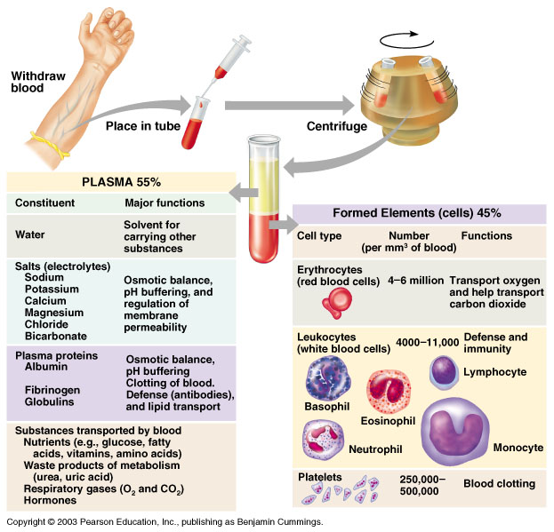

Slide 4
General Characteristics
Red in color (NOT BLUE): due to oxygenation of the hemoglobin protein on RBC’s
Viscous: thicker and stickier than water
Slightly alkaline: pH = 7.35-7.45
Acidosis: too acidic (too many H+)
Alkalosis: too basic (too few H+)
Volume: avg. male = 5-6 liters
avg. female = 4-5 liters

Slide 5
Blood Plasma
Liquid portion of blood
92% water and 8% dissolved elements
Formed elements, gases, metabolic wastes, nutrients & hormones
Components of plasma vary based on cell’s needs
Adjustments made in order to maintain homeostasis

Slide 6
Formed Elements
Erythrocytes aka Red Blood Cells (RBCs)
Anucleate cells; few organelles
Hematocrit: % of RBC’s to total blood volume
95% of formed elements
1000 RBC:1 WBC
Function: to transport O2 & CO2
Hemoglobin: iron containing protein on RBC’s; carries O2

Slide 7
RBC Life Cycle
Before birth: made in yolk sac, spleen & liver
After birth: made in red bone marrow
Life expectancy: 120 days because of no nucleus or organelles

Slide 8
Regulation of RBC Formation
Liver & kidneys monitor counts
Erythropoietin excreted from kidneys when counts are low—regulates hematopoiesis
10 billions die each HOUR
Macrophages eat toxins & debris
Iron recycled by red marrow
Hgb: broken down into bilirubin released as bile pigment by liver

Slide 9
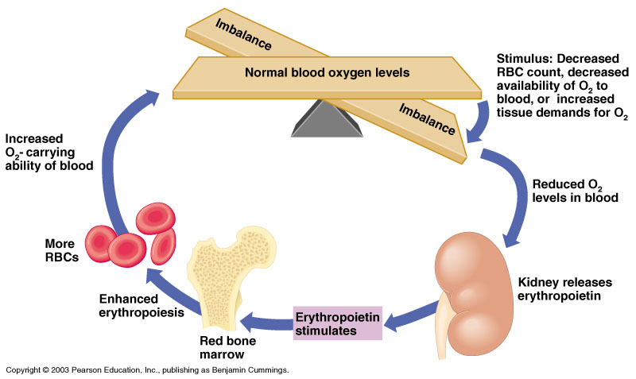
Control of Erythrocyte Production

Slide 10
Formed Elements
Leukocytes aka White Blood Cells (WBCs)
Make up less than 1% of blood volume
Function: used in body’s defense
Diapedesis: the ability to exit the blood stream to conduct an immune response
Positive chemotaxis: ability to locate bodily infection by responding to chemical signals

Slide 11
Types of Leukocytes
Granulocytes
Granules in their cytoplasm can be stained
Include neutrophils, eosinophils, and basophils

Slide 12
Formed Elements
Thrombocytes aka Platelets
Fragments of complete cells
1/10 size of RBC; shaped like an oval disc
Function: used in clotting process when blood cells are ruptured

Slide 13
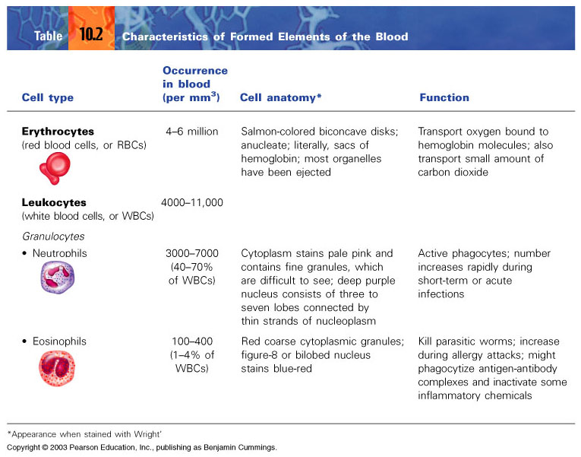

Slide 14
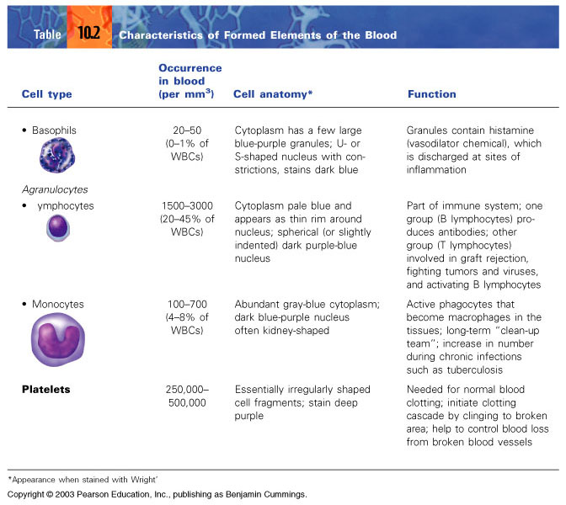

Slide 15
Hemostasis
Mechanism to stop bleeding
Blood vessel spasm: smooth muscle is stimulated to contract to bring broken ends of vessel together; lasts less than 30 minutes
Platelet Plug Formation: platelets become large and sticky and form a PLUG
Coagulation: series of events forming a blood clot

Slide 16
Blood Disorders
Thrombus: blood clot in vein or artery
Embolus: free floating thrombus; can be trapped in vessel causing stroke or heart attack
Hemophilia: inability to clot
Anemia: decreased O2 carrying capacity
Low RBC’s
Low hemoglobin

Slide 17
Blood Disorders
Sickle Cell Anemia: sickle shaped RBC’s that clog vessels and impairs blood flow
Polycythemia: excessive RBC’s causing increased viscosity & decreased blood flow
Leukemia: increased numbers of WBC’s; function abnormally

Slide 18
Blood Groups and Transfusions
Antigens: genetically determined proteins; the body recognizes them as “self” or “foreign”; stimulates immune system to release a defense (antibodies) against “foreigners”
Antibodies: recognizes antigens and decides if they are “foreign” or “self”

Slide 19
Blood Groups & Transfusions
Agglutination: clumping of RBC’s when antigen and antibody don’t match; leads to clogging of small vessels
Transfusion Reactions: when blood types don’t match causing: kidney failure, fever, vomiting, chills and nausea

Slide 21
Rh Blood Type
Rh(+): person having Rh antigens on RBC’s
Rh(-): person without Rh antigens on RBC’s
Rh sensitization: process by which an Rh(-) person develops anti-Rh antibodies due to exposure to Rh(+) blood

Slide 22
Rh Blood Type
Example: pregnant mother with Rh- blood; baby with Rh(+) blood from father
First baby: anti-Rh antibodies produced but no effect on baby
Second baby: anti-Rh antibodies enter fetal circulation causing hypoxia and anemia
Disorder called: erythroblastosis fetalis

Slide 23
The Heart
Function: transportation of nutrients and wastes via blood
Lies between the lungs in the thoracic cavity
Approximately the size of a fist
Weighs less than a pound

Slide 24
Anatomy of the Heart
Apex: pointed, inferior aspect of the heart
Base: broad, superior aspect of the heart

Slide 25
Serous Membrane
Pericardium AKA pericardial sac: the parietal peritoneum
Holds and protects the heart; makes pericardial fluid
Epicardium: outer layer of heart wall
Serves to protect the heart
Separated from pericardium by pericardial cavity

Slide 26
Walls and Coverings: 3 layers
Epicardium
Myocardium: ring-like arrangements of cardiac muscle
the part that contracts
Endocardium: white membrane
lines inside of heart chambers & blood vessels
reduces friction between wall and blood flow

Slide 27
Heart Chambers
Two atria
Receiving chambers
Auricles: extensions that allow for increase in volume
Do not aid in pumping; myocardium very thin
Filled with blood from veins and acts to fill ventricles with blood
Separated by interatrial septum
Fossa Ovalis: remains of fetal heart opening

Slide 28
Heart Chambers
Two Ventricles
Discharging chambers (actual pumps)
Propels blood into circulation
Thicker walls than atria
Left thicker than right
Separated by interventricular septum

Slide 29
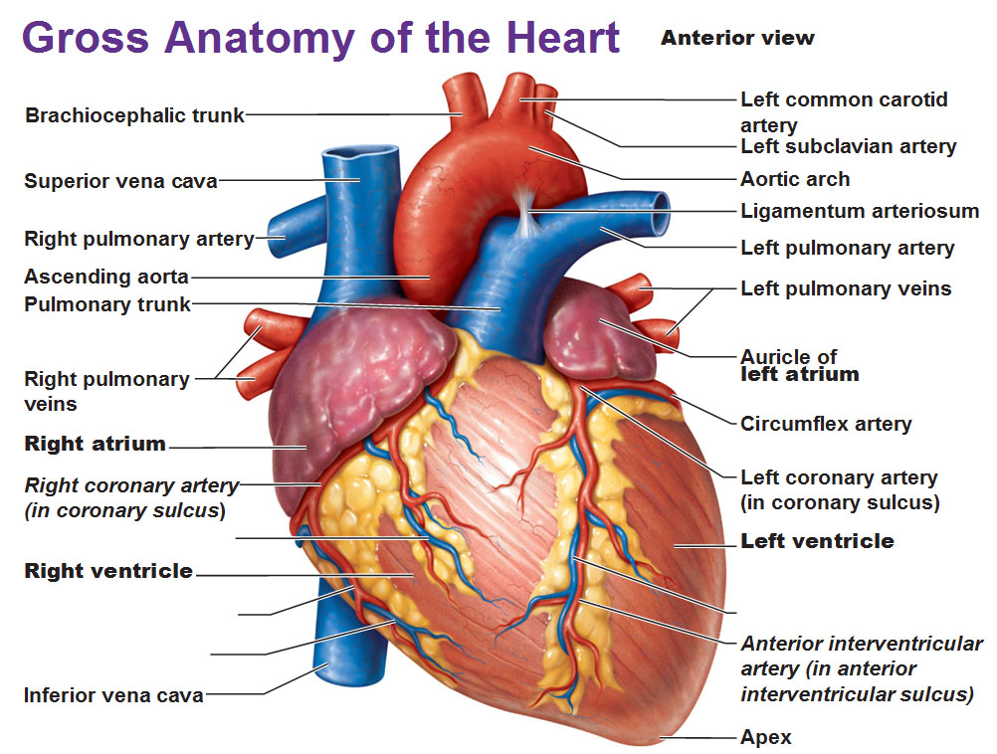
Anatomy of the Heart

Slide 30
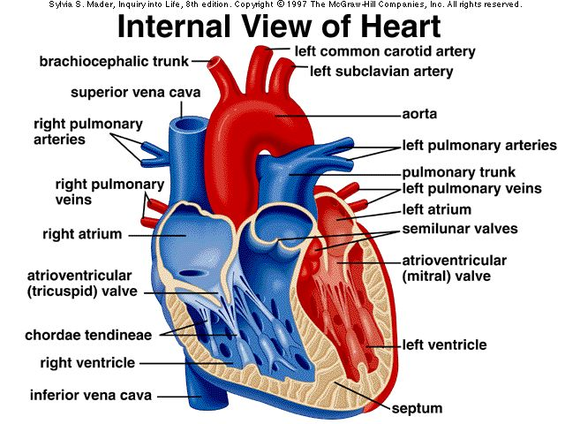
Internal Anatomy of the Heart

Slide 31
Heart Valves: Atrioventricular Valves
Atrioventricular Valves (AV valves)
Located between atria and ventricles
Anchored to papillary muscles via chordae tendinae
Tricuspid Valve: lies between R atrium and ventricle; has 3 cusps
Bicuspid Valve (mitral valve): lies between L atrium and ventricle; has 2 cusps

Slide 32
Atrioventricular Valves Continued
Function: permits one-way flow of blood from atria to ventricles ONLY upon atrial contraction
Ventricular contraction forces the AV valve flaps up, causing them to close off the opening to the atria and directing the flow of blood out of the heart

Slide 33
Heart Valves: Semilunar Valves
Semilunar Valves
Located between the ventricles and their major arteries
Made of 3-half moon shaped cusps each
1. Pulmonary valve: between R ventricle and pulmonary artery
Aortic valve: between L ventricle and aorta

Slide 34
Semilunar Valves Continued
Function: to direct one-way flow of blood from the ventricles to the pulmonary trunk and aorta
Ventricular contraction forces SL valves open (& AV valves shut)
All due to pressure increases
Ventricular relaxation causes closure of SL valves, preventing backflow

Slide 35
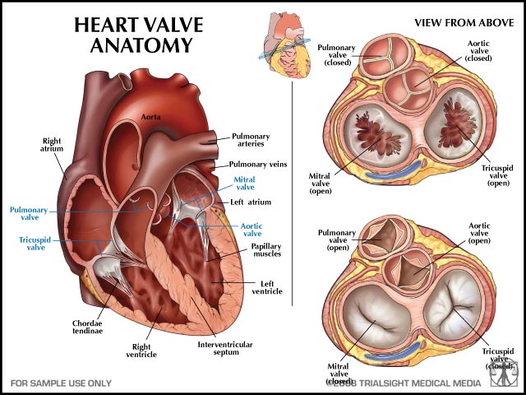
Heart Valves

Slide 36
Blood Flow Through The Heart
1.) Blood enters the R atrium and exits the heart via the L ventricle. In that time it leaves the heart to exchange gas in the lungs.
2.)Trace the path of blood flow through the heart naming all of the chambers, valves and vessels it passes through along the way!

Slide 37
Blood Flow Through the Heart

Slide 38
Supplying Blood to the Heart
Coronary Circulation: the flow of blood to the heart itself
The nutrients found in the blood cannot be absorbed from the internal chamber walls in order to nourish the myocardium
R & L Coronary Arteries: found at base of aorta; supplies heart with nourishing blood
Coronary Sinus: “waste” blood brought back to the R atrium

Slide 39
Circulation
Pulmonary Circulation: the route of blood between the lungs and heart
Systemic Circulation: the route of blood transport between the heart and all organs and tissues (except the lungs)

Slide 40
Vessel Walls
3 layers in arteries and veins
Tunica Intima: surrounds lumen
Very elastic
Tunica Media: smooth muscle and elastic fibers
Tunica Adventitia: thin layer
Anchors artery to neighboring structures

Slide 41
Circulation
Arteries: transports blood away from the heart
Highly elastic
Lumen becomes progressively smaller as the arteries branch
Blood pressure HIGH
Arterioles: same function as arteries
Thinner walls
Smaller lumens
Capillaries: microscopic vessels where exchange takes place
Walls made of squamos epithelium

Slide 42
Circulation
Venules: returns “wasted” blood to heart
Larger in diameter than capillaries
Increase in size en route to heart
Formed from the union of capillaries
Veins: returns “wasted” blood to heart
Larger lumens than venules
Distensible: walls able to distend/stretch
LOW blood pressure
Blood flow variations
Muscular and Respiratory pumps
One-way valves

Slide 43
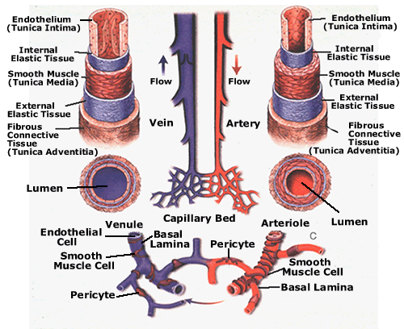
Blood Vessels

Slide 44
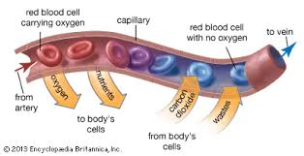
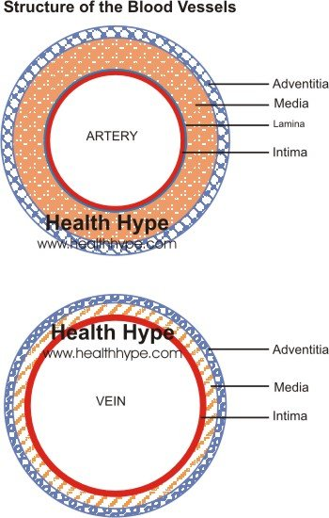
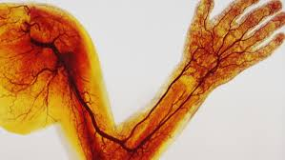
Blood Vessels

Slide 45
Circulation Irregularities
Varicose Veins: weakened valves allows blood to pool and permanently stretch vein walls
Hemorrhoids: varicosities in veins surrounding anal canal
Murmurs: defective valve
May shunt blood to organs

Slide 46
Heart Physiology: Cardiac Cycle
The cyclic contraction of both atria and ventricles
These events make up 1 heartbeat
Beat rhythmically: atria beat, then ventricles; atria beat, then ventricles ETC.
Blood moves due to pressure changes

Slide 47
Heart Physiology: Cardiac Cycle
Pressure changes:
Systole: state of contraction; high pressure within that specific chamber
Allows blood to exit chamber
Diastole: state of relaxation; low pressure within that specific chamber
Allows blood to enter chamber

Slide 48
Heart Physiology: Heart Sounds
“Lub-Dup, pause, lub-dup, pause, lub-dup, pause”
Cause: vibrational sounds of heart valve closures
Lub = closing of AV valves with ventricular systole
Dup = closing of SL valves with ventricular diastole

Slide 49
Heart Physiology: Heart Conduction System
Heart receives impulses from autonomic system, but can beat without nervous stimulation
Cardiac cells INHERENTLY contract
Conduction system: patches of pace-setting cardiac cells

Slide 50
Heart Physiology: Heart Conduction System
Sinoatrial (SA) Node: located in upper wall of R atrium
aka “Pacemaker”
Initiates each cardiac cycle
Generates electrical impulses causing atrial contraction
Stimulates AV node

Slide 51
Heart Physiology: Heart Conduction System
Atrioventricular (AV) Node: located on the R, inferior portion of the interatrial septum
Activated by SA Node
Generates impulses down conducting fibers: AV Bundle (Bundle of His)
AV Bundle follows interventricular septum and sends impulses left and right as it travels

Slide 52
Heart Physiology: Heart Conduction System
AV Node Continued
At apex of heart, AV Bundle forms branches called Purkinje Fibers
Purkinje Fibers pass deep into myocardium and initiate ventricular systole
Contraction occurs upward: a wringing motion from apex towards base of heart

Slide 53
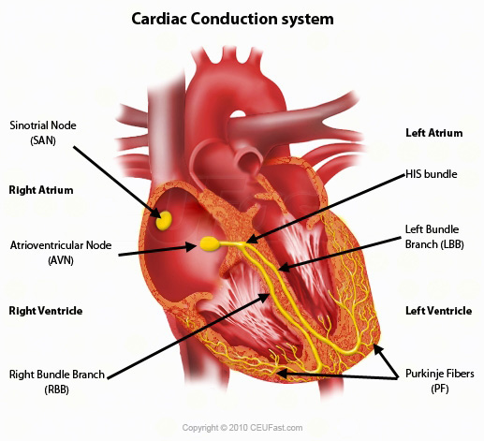
Heart Conduction
You Tube
Cardiac Conduction System - Electrical System of the Heart Animation - MADE EASY

Slide 54
Electrocardiogram
Electrocardiogram (ECG or EKG): an instrument that records the electrical changes in the myocardium
Flat baseline: myocardium polarized
P wave: SA node fires; atria depolarized
QRS complex: AV node fires; ventricles depolarized
T wave: ventricular repolarization

Slide 55
Cardiac Output (CO)
A measurable value that represents heart activity
Heart Rate (HR): number of heart beats (cardiac cycles) per minute
Avg. adult 75 beats/min.
Stroke Volume (SV): volume of blood ejected by ventricles per heart beat
Avg. adult 70 ml/min.

Slide 56
Cardiac Output
CO = HR X SV
Avg. resting adult:
75/min X 70ml./min. = 5250 ml./min
-OR-
5.2 liters of blood pumped through the body EACH MINUTE at rest!

Slide 57
Starlings Law of the Heart
How far cardiac cells are stretched (how full the chambers get), the stronger the heart will contract

Slide 58
Blood Pressure (BP)
The force exerted by blood against the inner walls of vessels
Highest pressure in aorta, lowest in veins
Blood moves from high to low pressure
Read using a sphygmomanometer
Systole/diastole: avg. adult = 120/80

Slide 59
Factors Affecting Blood Pressure
1.) Cardiac Output: increase in CO = increase in BP
2.) Peripheral Resistance (PR): the friction or drag produces when blood passes over vessel walls
smaller lumens = high PR
greater blood viscosity = high PR
high PR = high BP

Slide 60
Factors Affecting Blood Pressure
3.) Blood Volume: a measure of the amount of blood plasma & formed elements present in the cardiovascular system
Blood volume drops = BP drops

Slide 61
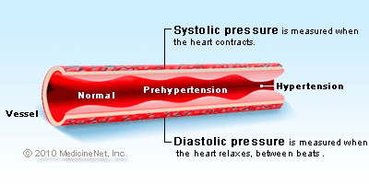
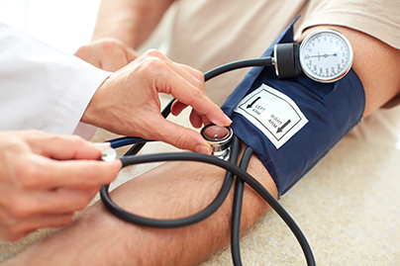
Blood Pressure

