Slide 1
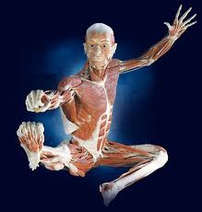
Directional Terms & Planes
Anatomy and Physiology

Slide 2
Anatomical Orientation
Standard position of the body
Why?
Must have a reference point for directional terms and descriptions

Slide 3
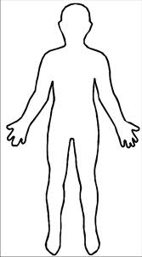
Superior (cranial)
Toward the head or
upper part of body
Example: nose is superior to the neck

Slide 4
Inferior (Caudal)
Away from head or
toward lower part of body
Example: The naval is inferior
to the breastbone.

Slide 5
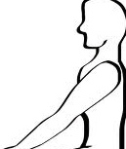
Anterior (Ventral)
Front of body; in front of
Example: rib cage is anterior spine

Slide 6
Posterior (Dorsal)
Backside of body; behind
Example: The spine is posterior to
the heart.

Slide 7
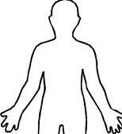
Medial
Toward or at midline of body;
inner side of
Example: Heart is medial to arm

Slide 8
Lateral
Away from midline;
outer side of
Example: Arm is lateral to chest

Slide 9
Superficial (External)
Toward or at body surface
Example: Skin is superficial to skeleton

Slide 10
Deep (internal)
Away from body surface; internal
Example: Lungs deep to rib cage

Slide 11
Proximal
Close to origin or point
of attachment of limb to
body trunk
Example: knee is proximal to ankle
This means that the knee is closer to the point of
Attachment than the ankle.

Slide 12
Distal
Farther from origin or
point of attachment of limb
to body trunk
Example: ankle is distal to the knee

Slide 13
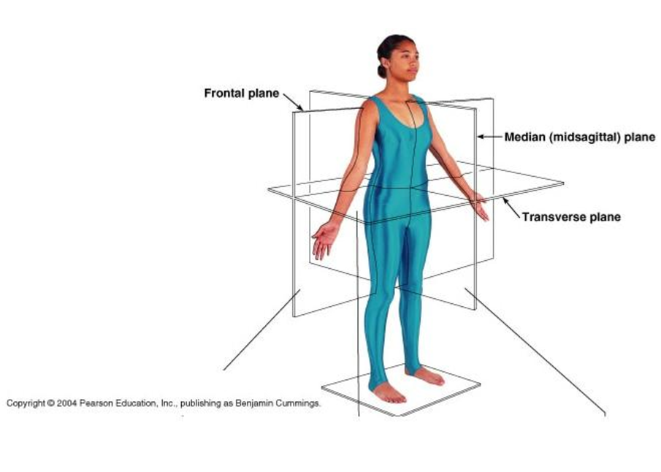
Transverse Section
Cut along horizontal plane
Divides body into superior & inferior parts
Cross Sections

Slide 14
Transverse Plane

Slide 15
Sagittal Section
Cut along lengthwise (longitudinal) plane
Divides into left and right parts
Midsaggital or median section – cut is down median plane
to make equal parts

Slide 16
Midsagittal Plane

Slide 17
Frontal Section
Cut along lengthwise plane
Divides into posterior and anterior parts

Slide 18
Frontal Plane

