Slide 1
Chapter 6 The Muscular System
Essentials of Human Anatomy & Physiology
Seventh Edition
Elaine N. Marieb
Slides 6.32 – 6.44
Lecture Slides in PowerPoint by Jerry L. Cook
Copyright © 2003 Pearson Education, Inc. publishing as Benjamin Cummings

Slide 2
Slide 6.32
Types of Ordinary Body Movements
Flexion
Extension
Rotation
Abduction
Circumduction
Copyright © 2003 Pearson Education, Inc. publishing as Benjamin Cummings

Slide 3
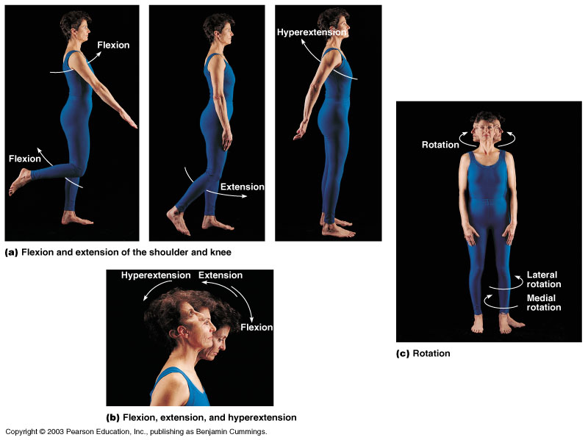
Slide 6.33
Body Movements
Figure 6.13
Copyright © 2003 Pearson Education, Inc. publishing as Benjamin Cummings

Slide 4
Slide 6.34
Special Movements
Dorsifelxion
Plantar flexion
Inversion
Eversion
Supination
Pronation
Opposition
Copyright © 2003 Pearson Education, Inc. publishing as Benjamin Cummings

Slide 5
Slide 6.35
Types of Muscles
Prime mover – muscle with the major responsibility for a certain movement
Antagonist – muscle that opposes or reverses a prime mover
Synergist – muscle that aids a prime mover in a movement and helps prevent rotation
Fixator – stabilizes the origin of a prime mover
Copyright © 2003 Pearson Education, Inc. publishing as Benjamin Cummings

Slide 6
Slide 6.36a
Naming of Skeletal Muscles
Direction of muscle fibers
Example: rectus (straight)
Relative size of the muscle
Example: maximus (largest)
Copyright © 2003 Pearson Education, Inc. publishing as Benjamin Cummings

Slide 7
Slide 6.36b
Naming of Skeletal Muscles
Location of the muscle
Example: many muscles are named for bones (e.g., temporalis)
Number of origins
Example: triceps (three heads)
Copyright © 2003 Pearson Education, Inc. publishing as Benjamin Cummings

Slide 8
Slide 6.37
Naming of Skeletal Muscles
Location of the muscles origin and insertion
Example: sterno (on the sternum)
Shape of the muscle
Example: deltoid (triangular)
Action of the muscle
Example: flexor and extensor (flexes or extends a bone)
Copyright © 2003 Pearson Education, Inc. publishing as Benjamin Cummings

Slide 9
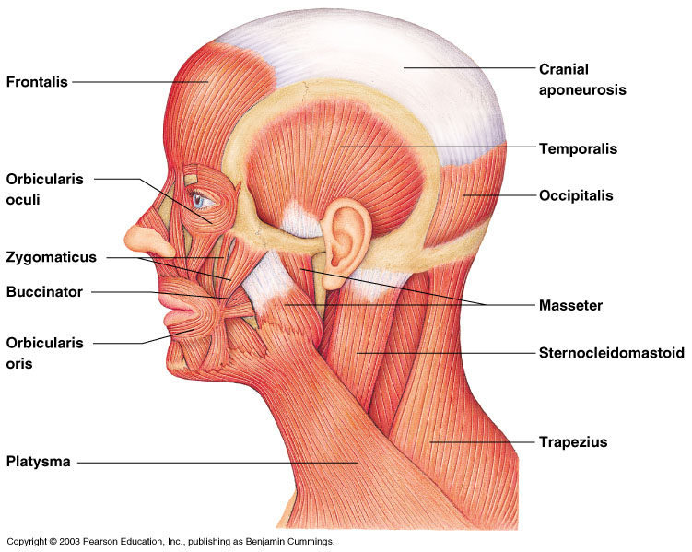
Slide 6.38
Head and Neck Muscles
Figure 6.14
Copyright © 2003 Pearson Education, Inc. publishing as Benjamin Cummings

Slide 10
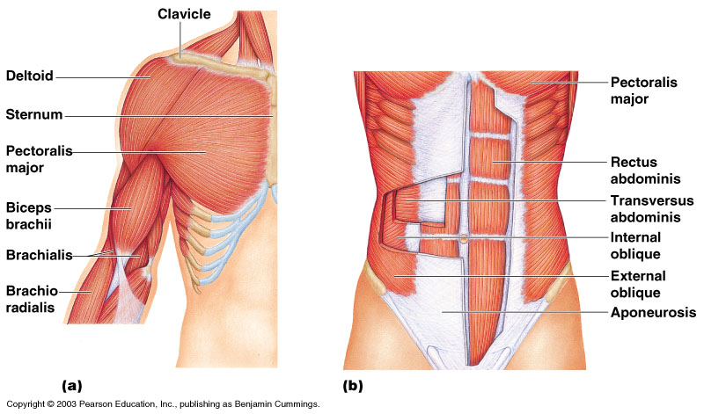
Slide 6.39
Trunk Muscles
Figure 6.15
Copyright © 2003 Pearson Education, Inc. publishing as Benjamin Cummings

Slide 11
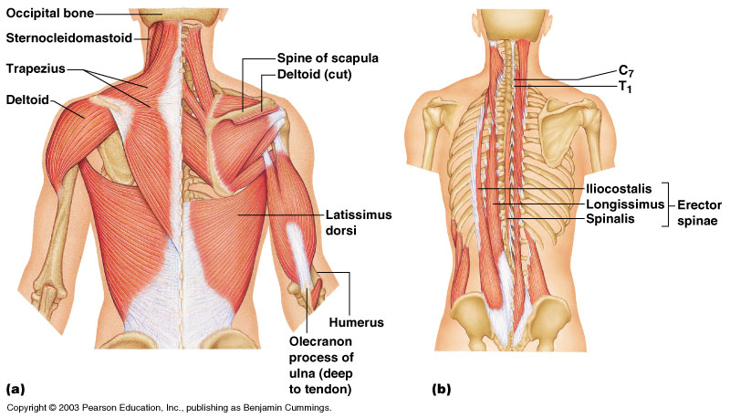
Slide 6.40
Deep Trunk and Arm Muscles
Figure 6.16
Copyright © 2003 Pearson Education, Inc. publishing as Benjamin Cummings

Slide 12
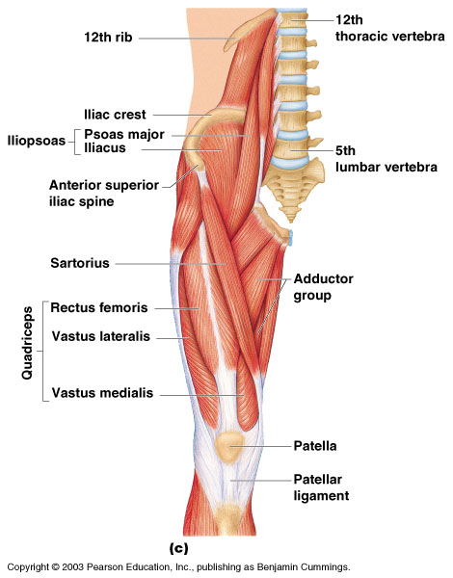
Slide 6.41
Muscles of the Pelvis, Hip, and Thigh
Figure 6.18c
Copyright © 2003 Pearson Education, Inc. publishing as Benjamin Cummings

Slide 13
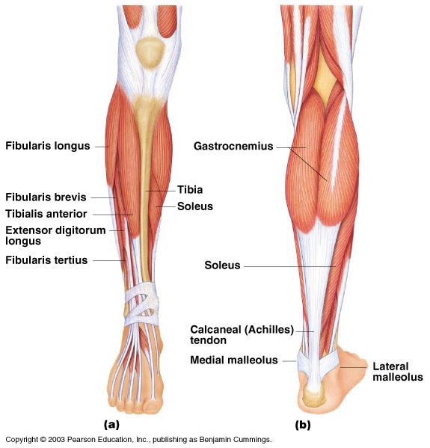
Slide 6.42
Muscles of the Lower Leg
Figure 6.19
Copyright © 2003 Pearson Education, Inc. publishing as Benjamin Cummings

Slide 14
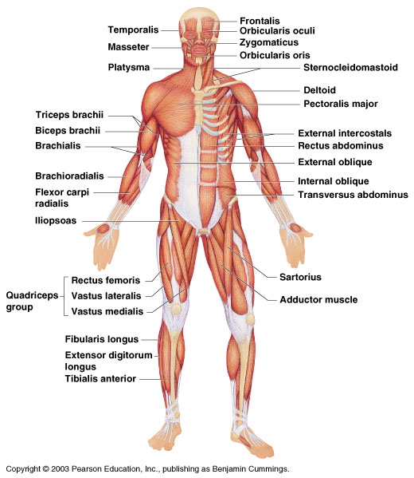
Slide 6.43
Superficial Muscles: Anterior
Figure 6.20
Copyright © 2003 Pearson Education, Inc. publishing as Benjamin Cummings

Slide 15
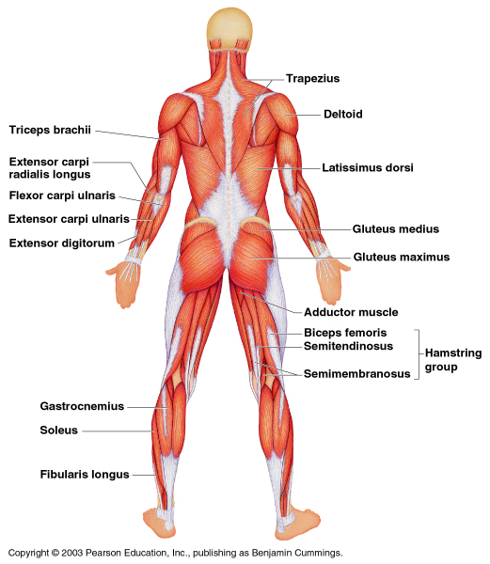
Slide 6.44
Superficial Muscles: Posterior
Figure 6.21
Copyright © 2003 Pearson Education, Inc. publishing as Benjamin Cummings

